Slide 1
Toy data analysis with SQL
Task 1 :
Mentorness Internship Project
By - Jack Titus .w

Slide 2
PROBLEM STATEMENT
What is the total sales revenue generated by each store?
Which products are the top-selling in terms of units sold?
What is the sales performance by product category?
What are the current inventory levels for each product at each store?
How do monthly sales trends vary across different stores?
Which stores have the highest and lowest sales performance?
What is the profit margin for each product?
How are sales distributed across different cities?
Which products are out of stock in each store?
How do sales vary by specific dates?
What is the average cost of products in each category?
What is the sales growth over time for the entire company?
How does the store open date affect sales performance?
What percentage of total sales does each store contribute?
How do sales compare to current stock levels for each product?

Slide 3
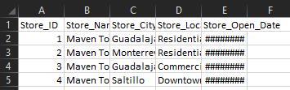
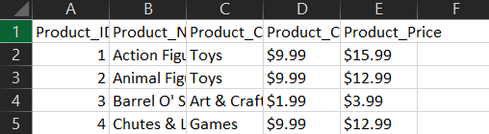
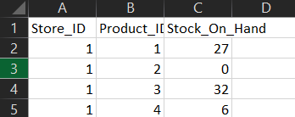
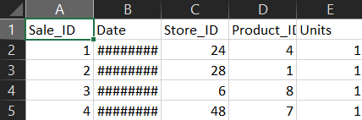
Dataset description :
Stores_stores.csv first 4 rows of stores_stores.csv
Store_ID: Unique identifier for the store.
Store_Name: Name of the store.
Store_City: City where the store is located.
Store_Location: Location details of the store.
Store_Open_Date: Date when the store was opened.
Sales.csv
Sale_ID: Unique identifier for the sale.
Date: Date the sale was made.
Store_ID: Identifier linking to the stores table.
Product_ID: Identifier linking to the products table. . First 4 rows of sales.csv
Units: Number of units sold
Product_products.csv First 4 rows of Products_product.csv
Product_ID: Unique identifier for the product.
Product_Name: Name of the product.
Product_Category: Category of the product
Product_Cost: Cost price of the product.
Product_Price: Selling price of the product.
Inventory_inventory_csv First 4 rows of inventory_inventory.csv
Store_ID: Unique identifier for the store.
Product_ID: Unique identifier for the product.
Stock_On_Hand: Number of units available in stock.

Slide 4
Primary Keys:
inventory: Composite of Store_ID and Product_ID
products: Product_ID
sales: Sale_ID
stores: Store_ID
Foreign Keys:
inventory.Store_ID → stores.Store_ID
inventory.Product_ID → products.Product_ID
sales.Store_ID → stores.Store_ID
sales.Product_ID → products.Product_ID

Slide 5
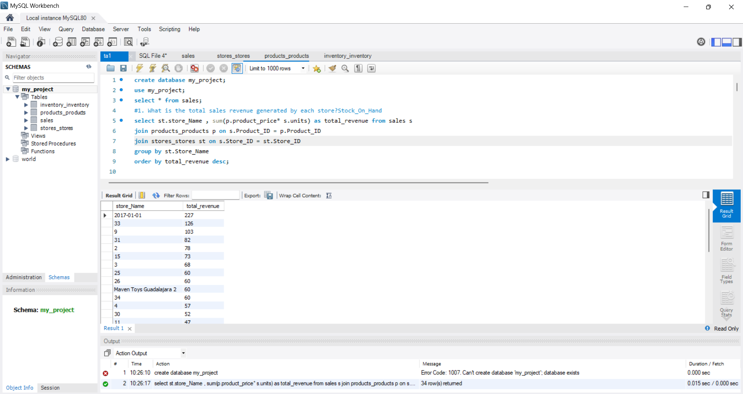
What is the total sales revenue generated by each store?

Slide 6
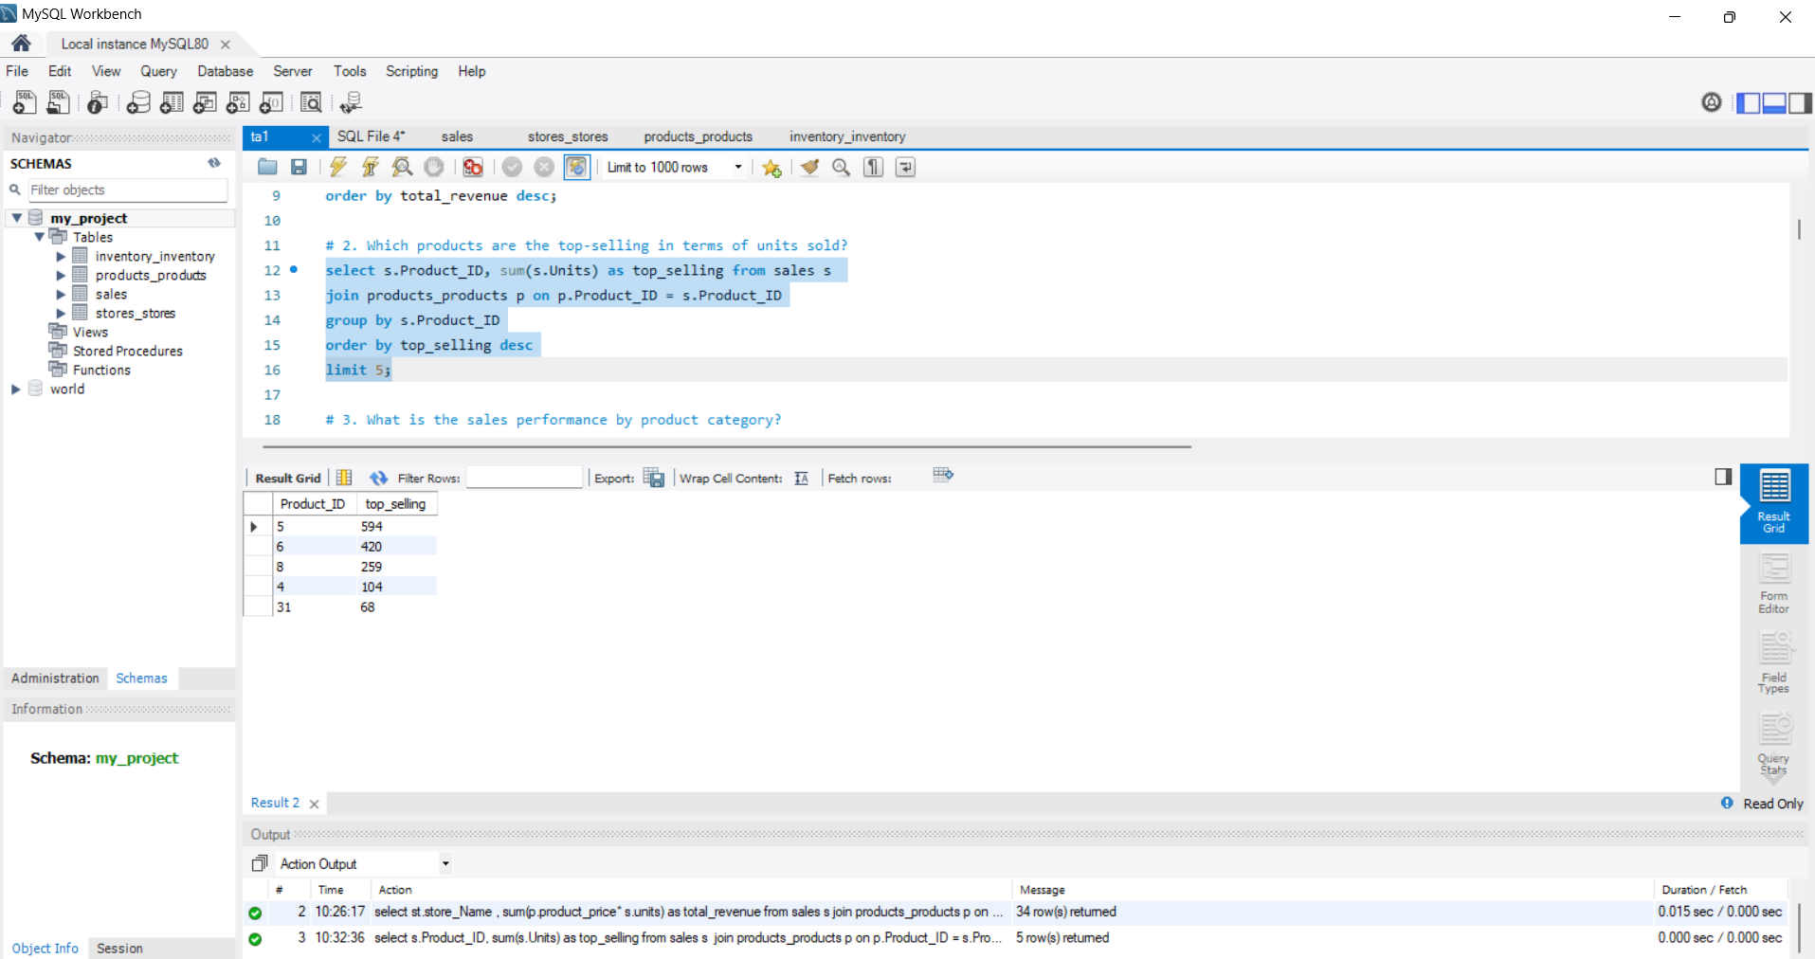
Which products are the top-selling in terms of units sold?

Slide 7
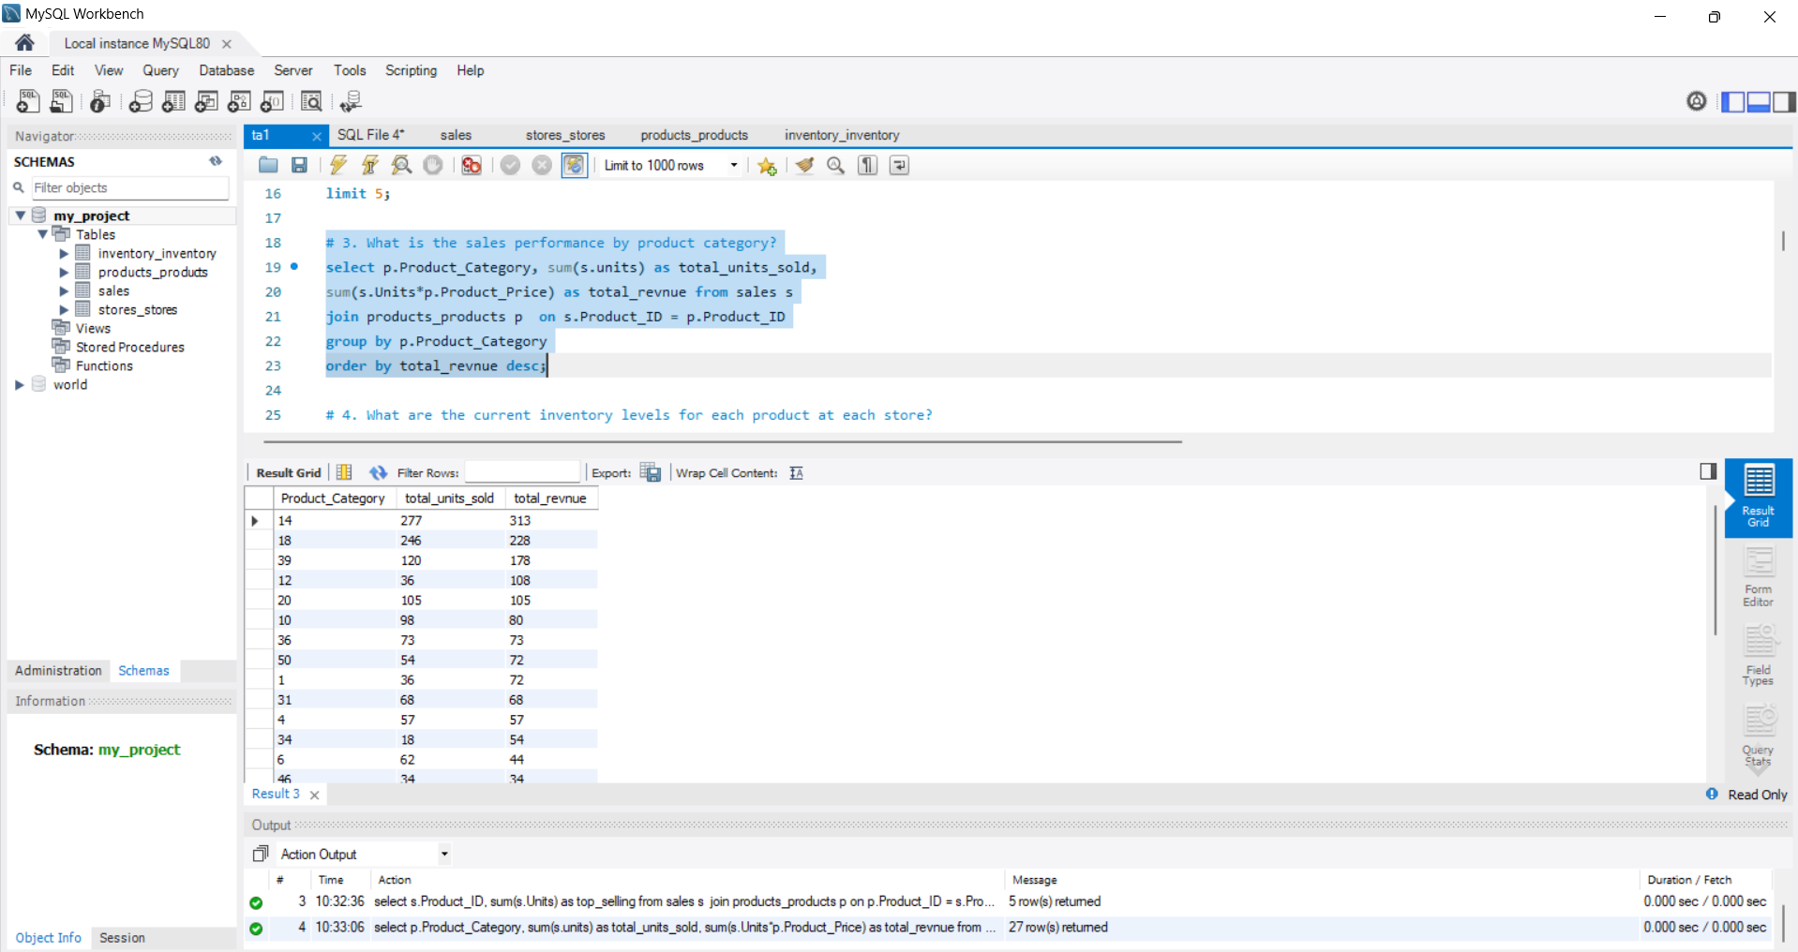
What is the sales performance by product category?

Slide 8
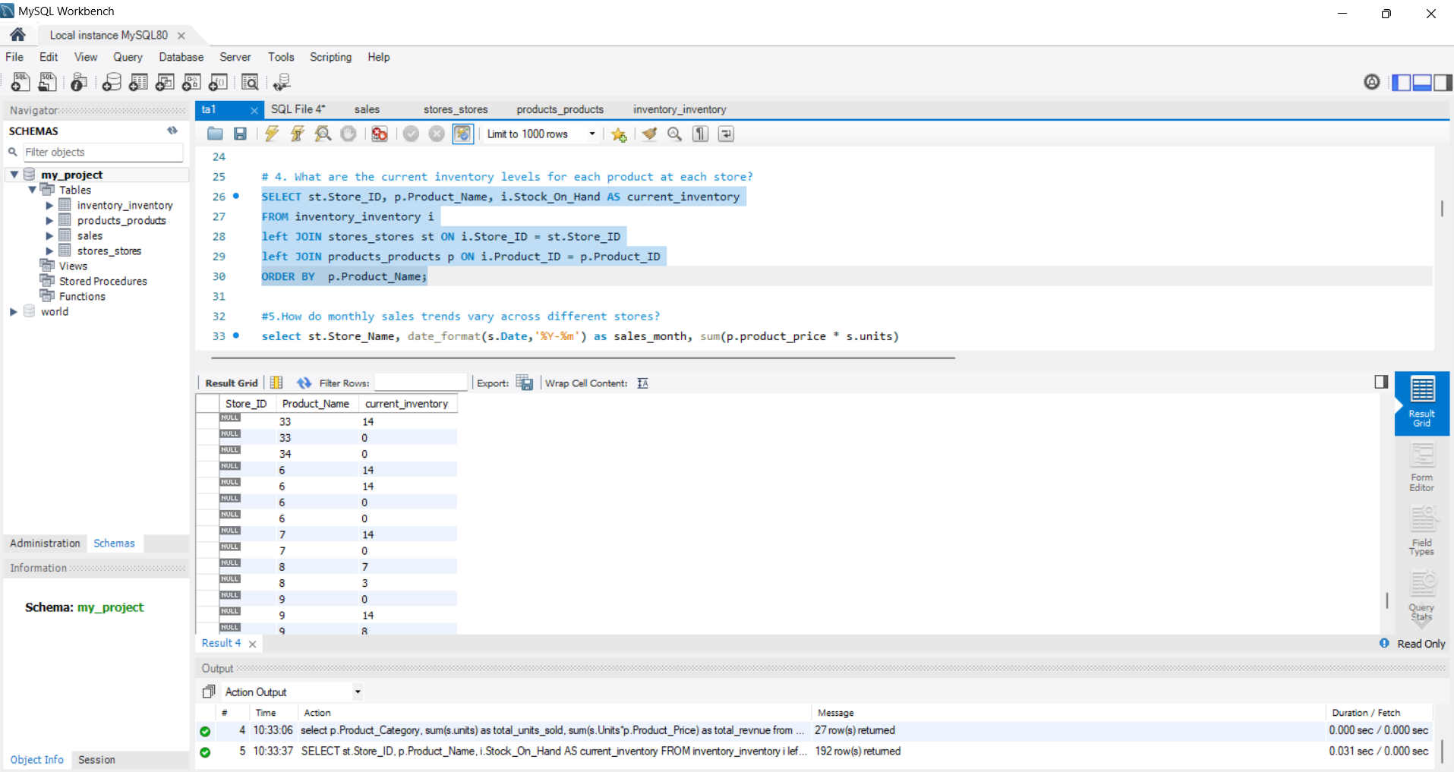
What are the current inventory levels for each product at each store?

Slide 9
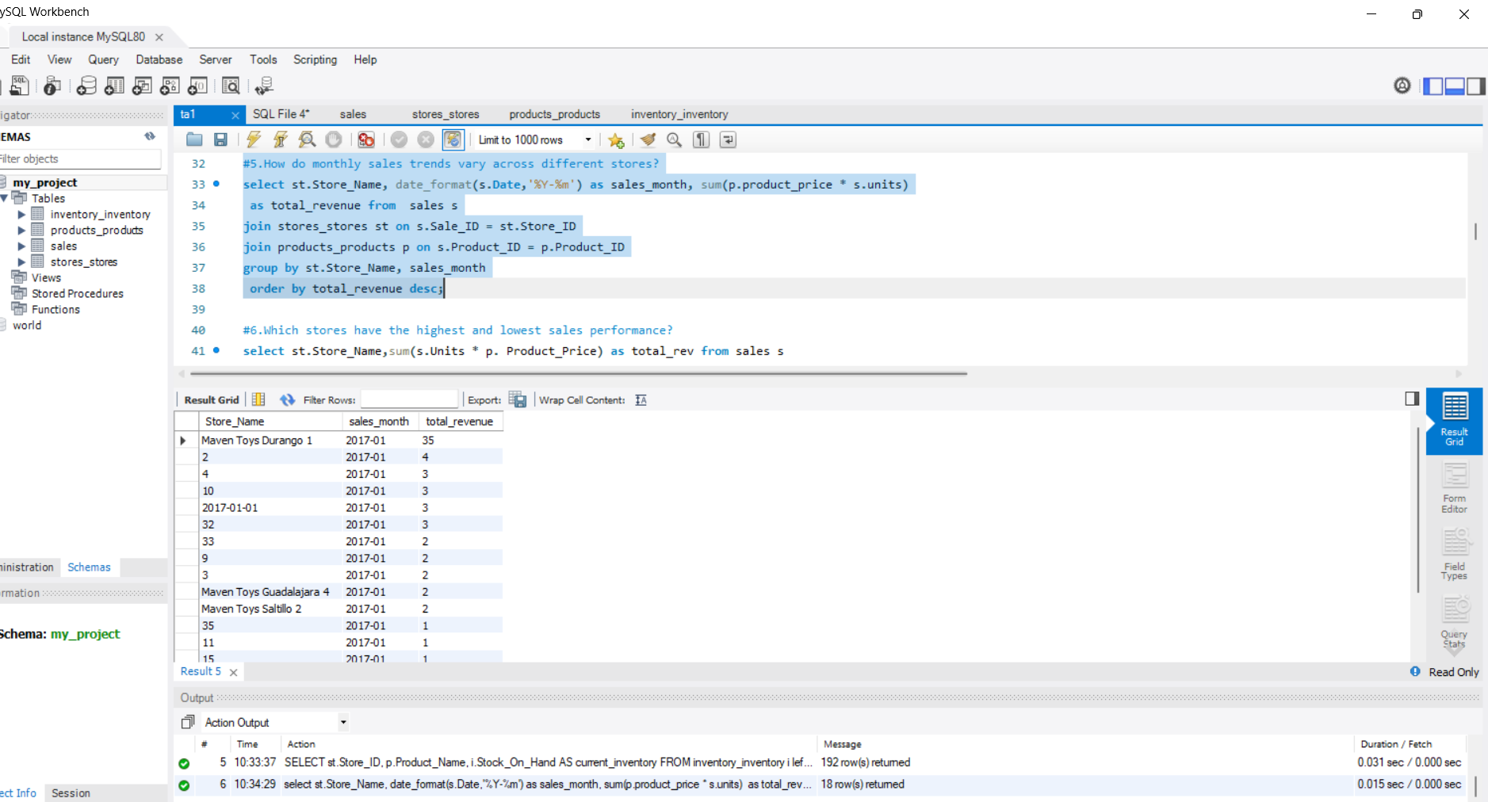
How do monthly sales trends vary across different stores?

Slide 10
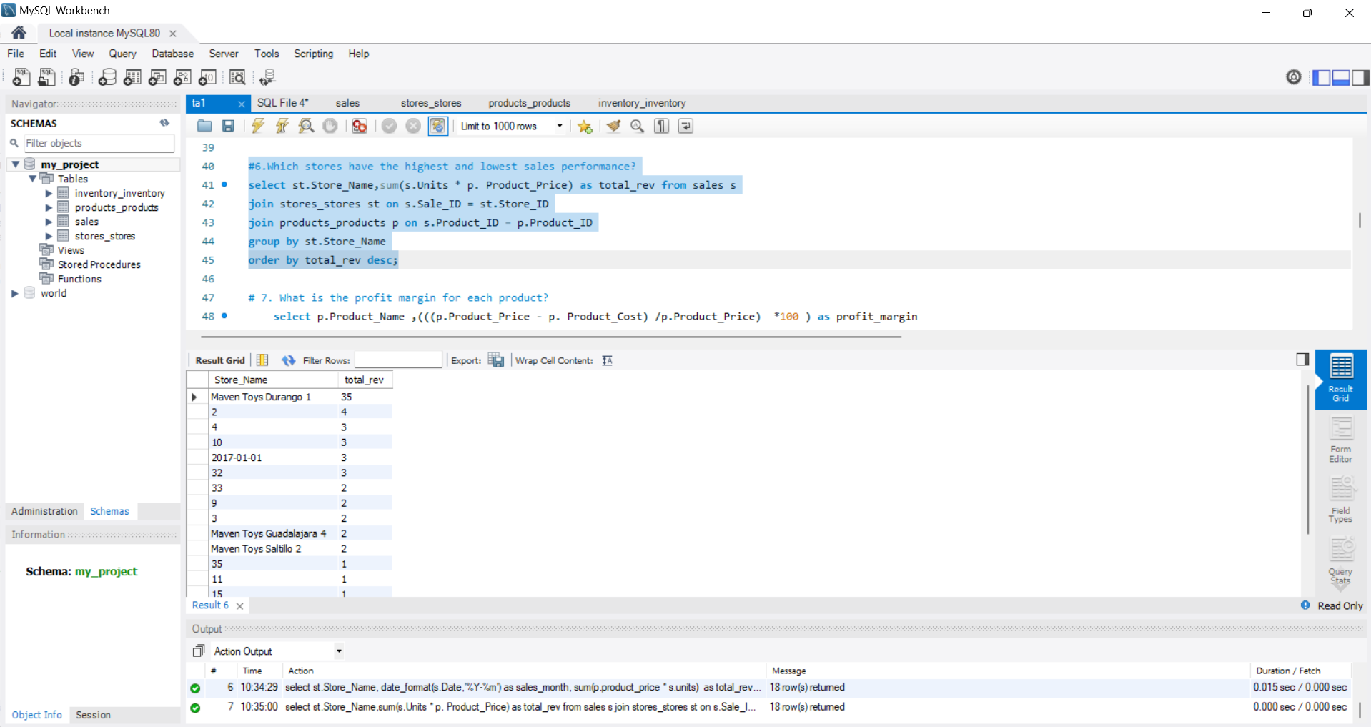
Which stores have the highest and lowest sales performance?

Slide 11
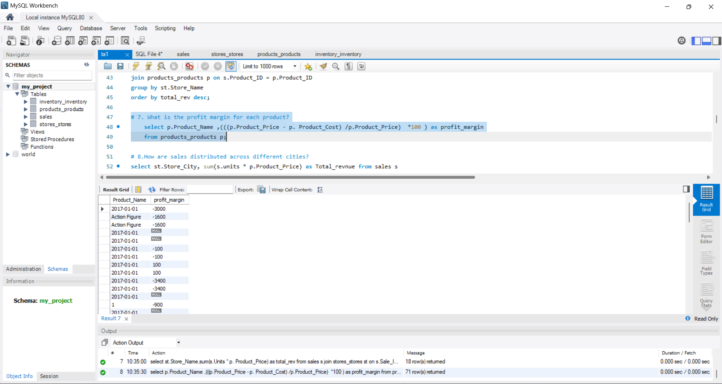
What is the profit margin for each product?

Slide 12
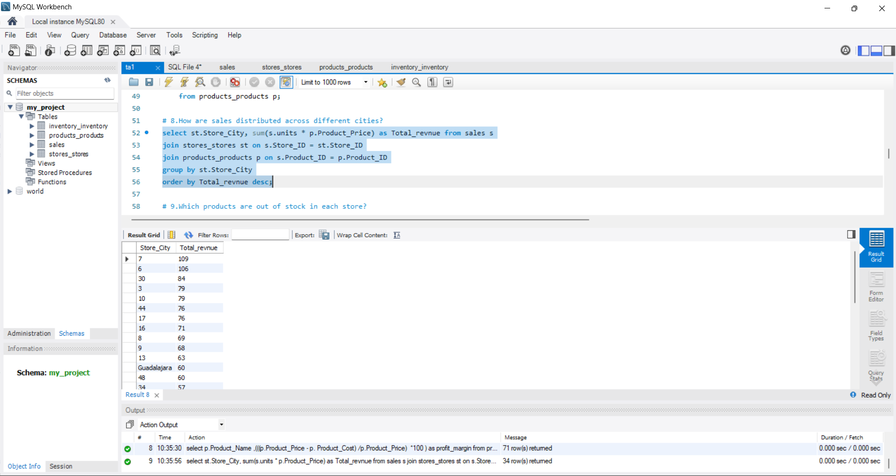
How are sales distributed across different cities?

Slide 13
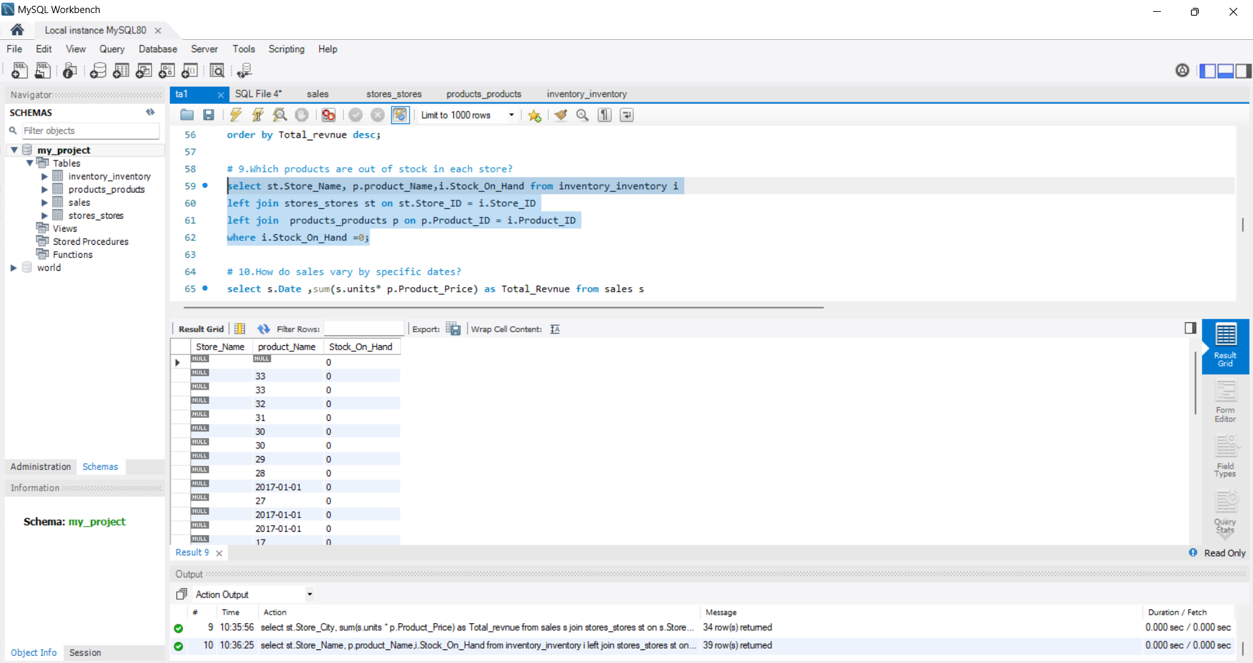
Which products are out of stock in each store?

Slide 14
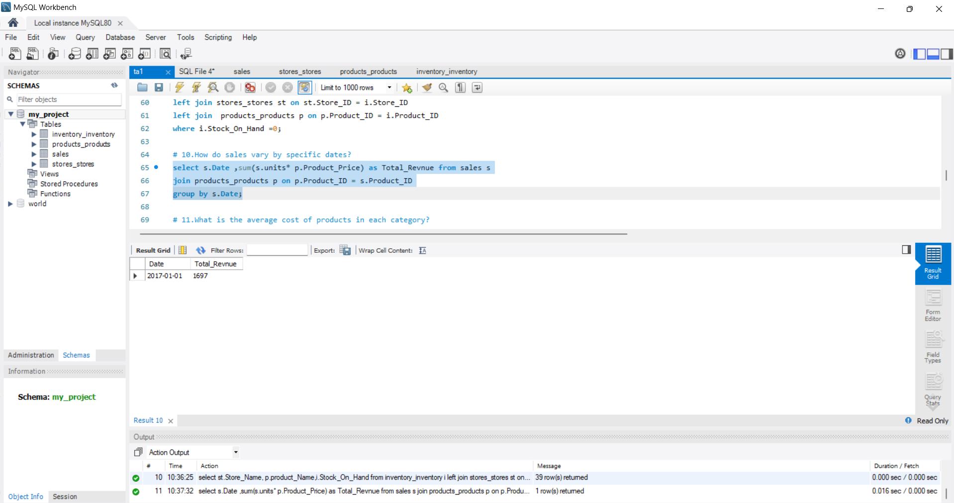
How do sales vary by specific dates?

Slide 15
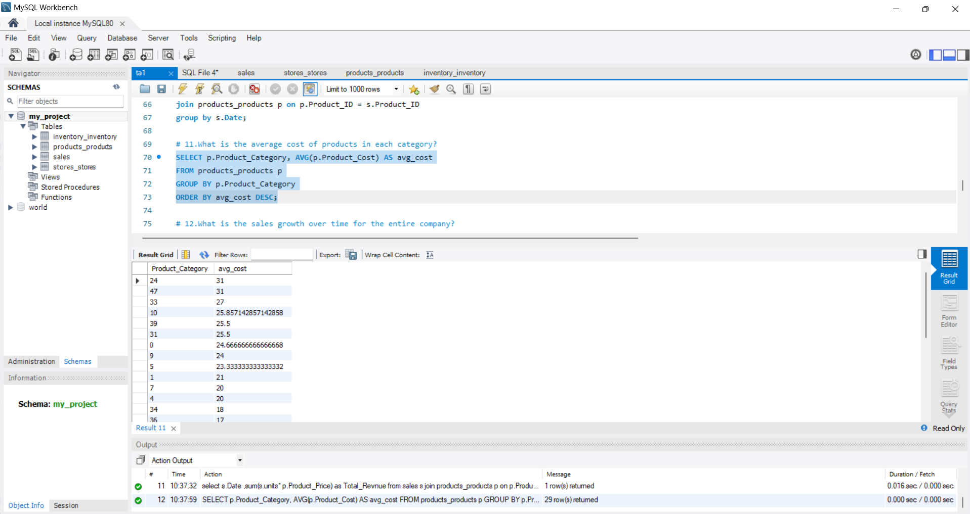
What is the average cost of products in each category?

Slide 16
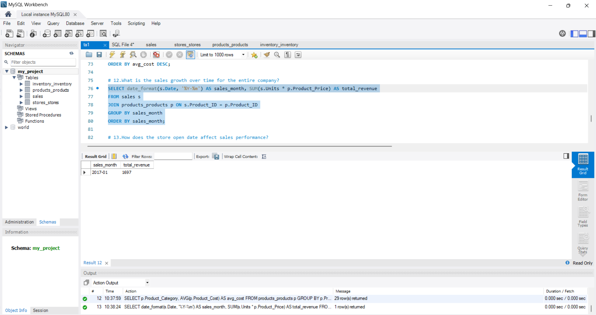
What is the sales growth over time for the entire company?

Slide 17
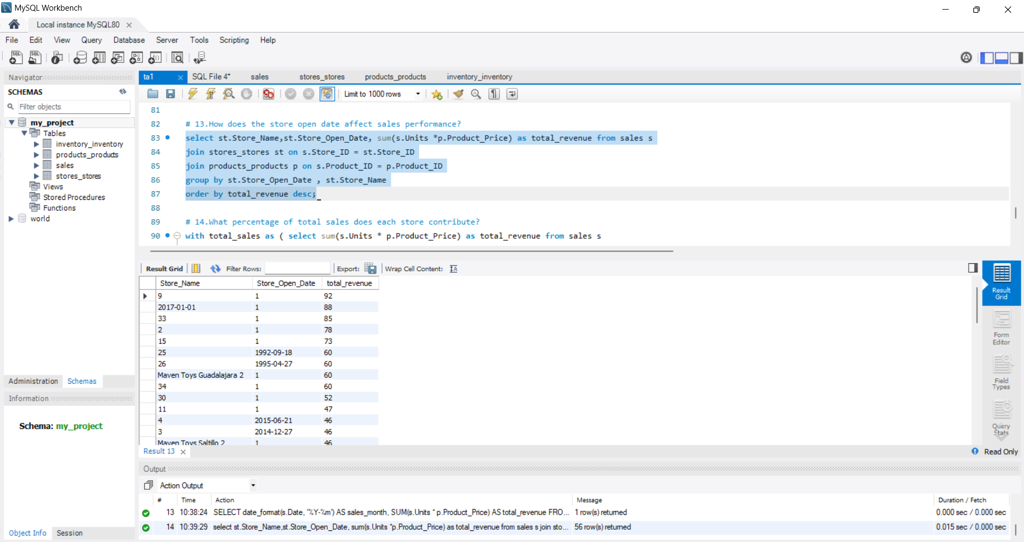
How does the store open date affect sales performance?

Slide 18
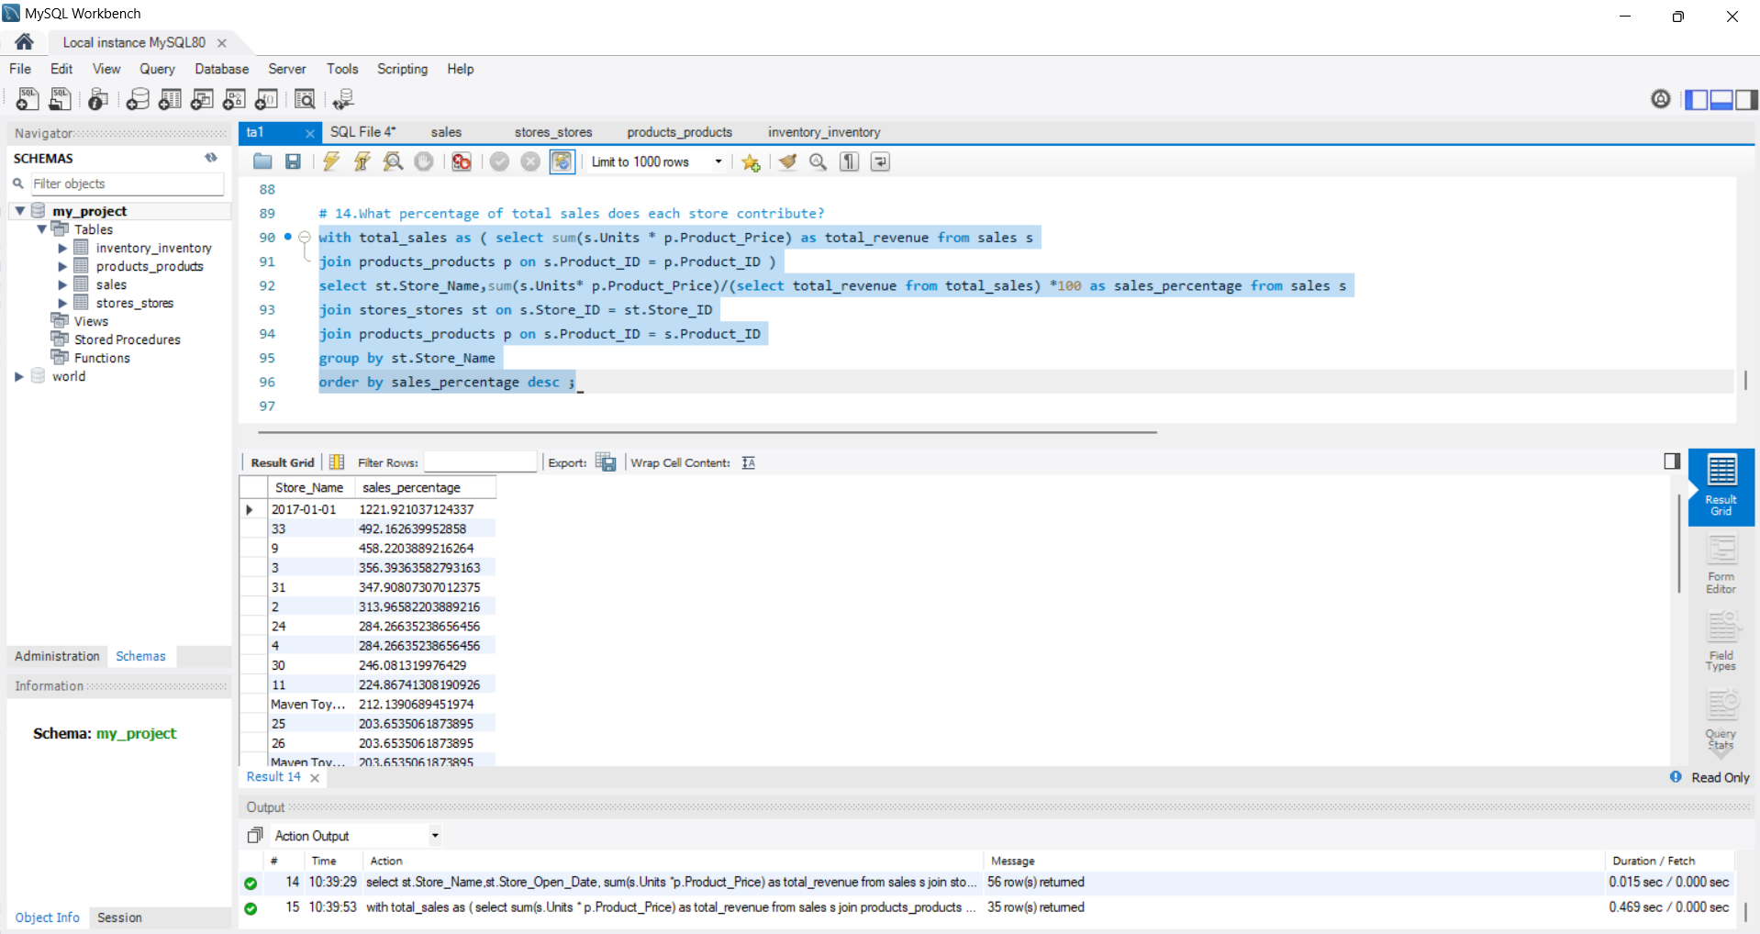
What percentage of total sales does each store contribute?

Slide 19
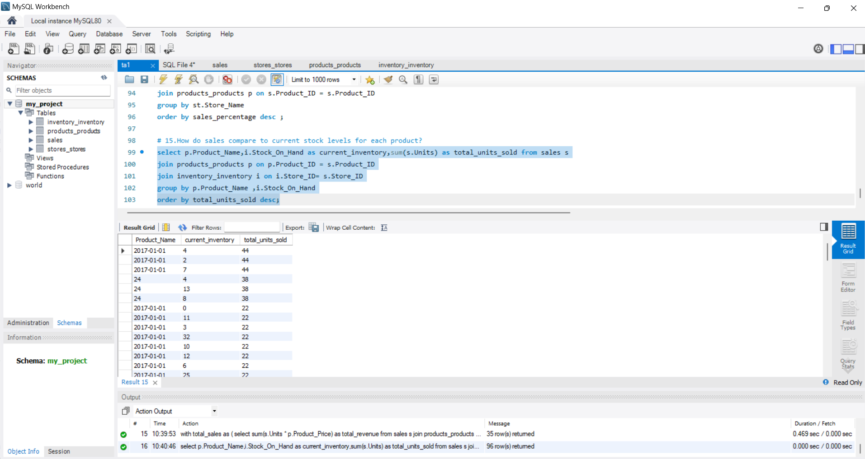
How do sales compare to current stock levels for each product?

